Slide 1



Problem Solving Concepts
Topic 2

Slide 2

Objectives
To describe nature of problems:
Concrete & Abstract
To learn about the types of solution for a problem
Algorithmic & Heuristic Solutions
To learn the steps involved in building a program
To learn problem solving through algorithm
pseudo code & flow chart

Slide 3

Introduction
The most important skill for a computer scientist is problem-solving:
the ability to formulate problems, think creatively about solutions, and express a solution clearly and accurately.
Programming involves
problem solving (design)
translating the solutions into a computer program using a programming language (a.k.a . coding)

Slide 4
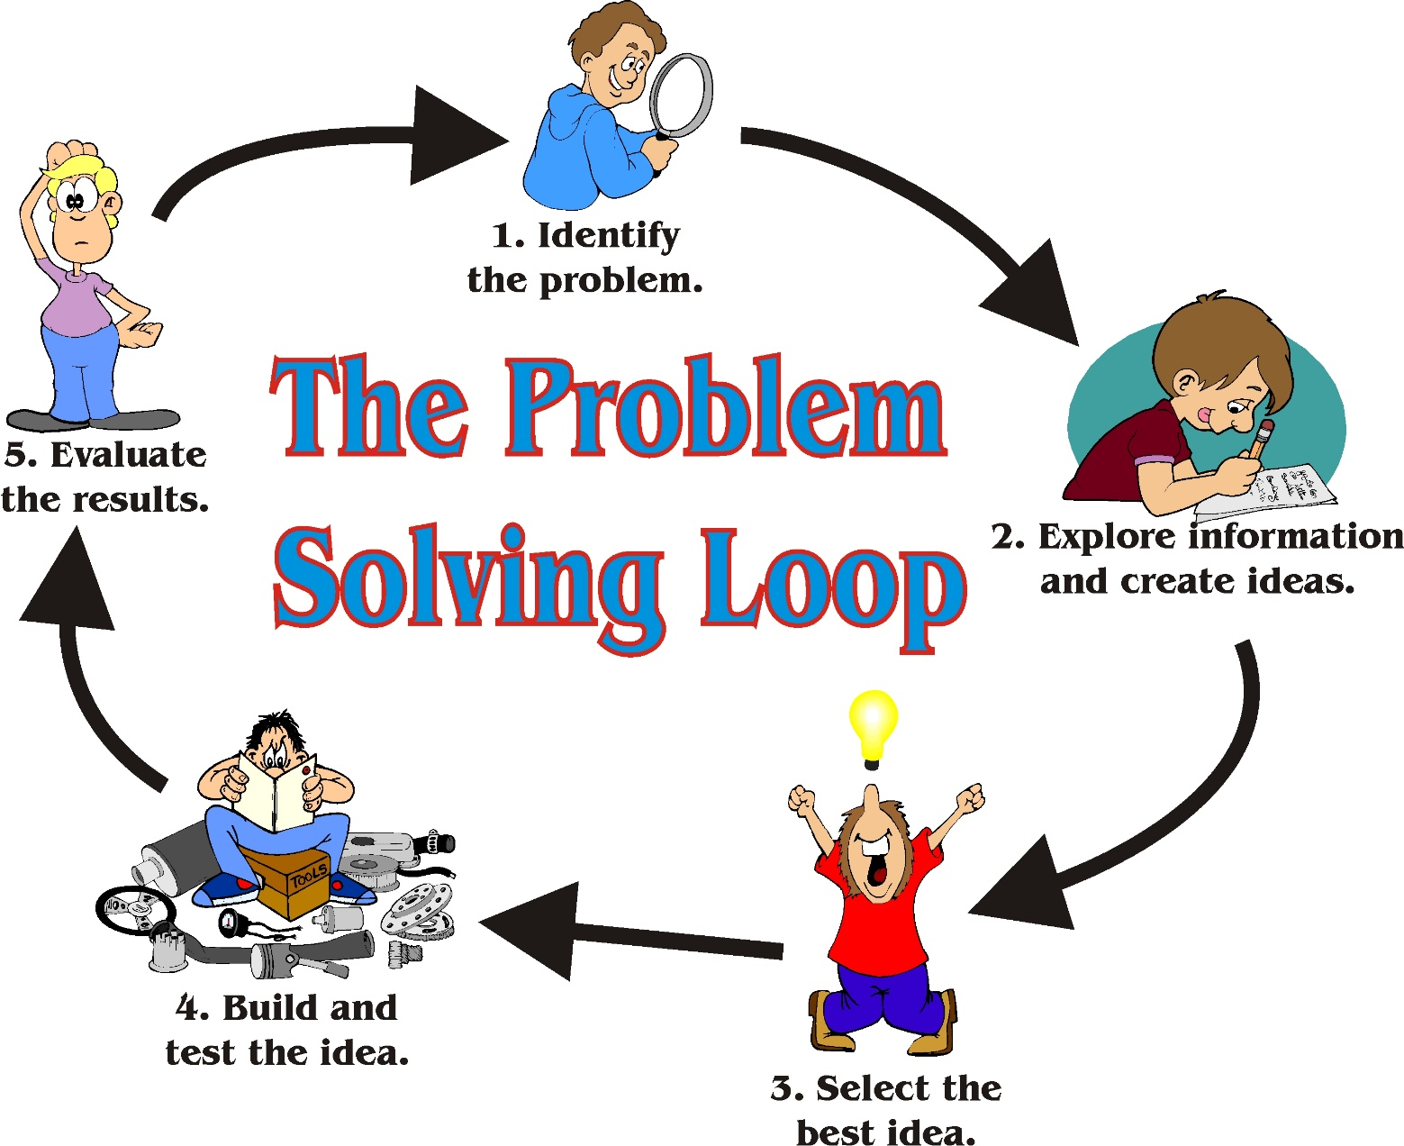
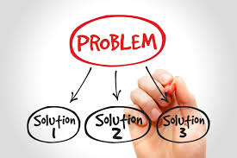

Slide 5
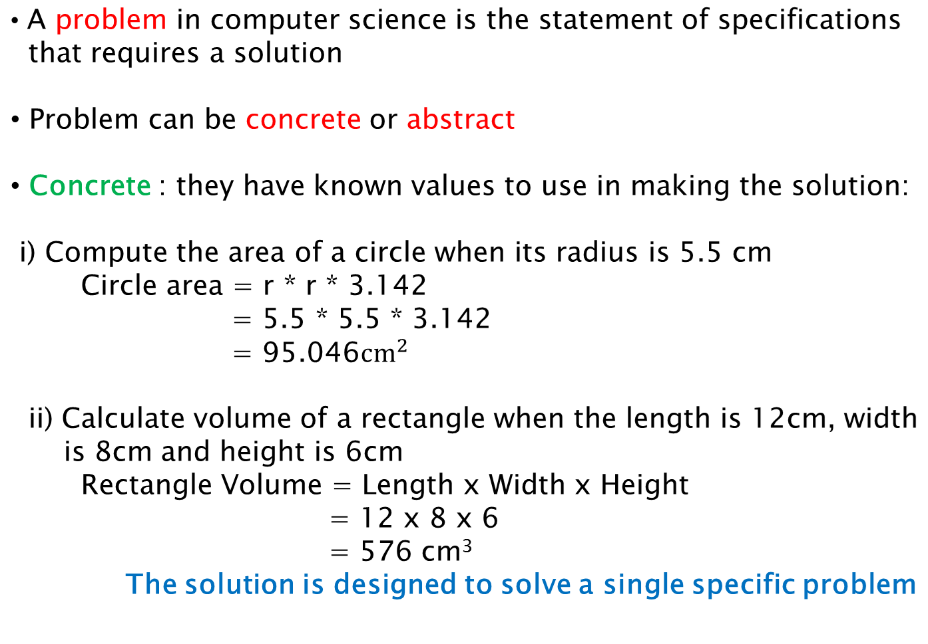
Nature of problem

Slide 6
Nature of problem
Abstract: they have no particular values to be used in making the solution:
Compute the area of a circle with a given radius
Calculate the monthly payment for a given loan amount with a specific loan duration and interest rate.
It requires an abstract/general solution which can solve several problems when concrete information is given.

Slide 7
Analogy: to calculate the area of 3 different rectangles WITH GIVEN VALUES
4cm
8cm
5cm
2cm
2cm
3cm
Rect 1
Rect 2
Rect 3
Area = 2 * 4
__________
__________
Area = 2 * 8
__________
__________
Area = 3 * 5
__________
__________
Concrete Problem
3 different Java programs

Slide 8
Analogy 2: to calculate the area of rectangles
Find general solution:
Rect area = Width * Length
Rect 1 = 2 * 4
Rect 2 = 2 * 8
Rect 3 = 3 * 5
_______
_______
_______
_______
1 Java program for 3 rectangles calculation
Concrete information
Abstract Problem

Slide 9
Types of Problem Solutions
Algorithmic Solutions
Well-defined steps/instructions for carrying out a particular task .
E.g. Calculating your bank account balance
Calculating the area of a circle
Calculating total salary
The solution will be the same each time the algorithm is followed.
Most computers use algorithmic types of problem solutions.
Notes:
So what types of problems do we deal with “usually”?
Most of the problems that we create for computers are algorithmic solutions. Algorithmic Solutions are a set of instructions that will be followed each time the program is run.
Calculating a payroll problem is an example of an algorithmic solution.

Slide 10
Types of Problem Solutions
Heuristic Solutions
Solutions that can’t be reached by following a direct set of steps.
Created by using reasoning built upon knowledge and experience and by trial and error. E.g. :
- Determining which road to take to reach UUM
- Deciding which group to choose for a subject
The solution may not be the same each time the algorithm is executed.
Artificial intelligence deals with heuristic types of problems.

Slide 11
Algorithmic VS Heuristic Solutions
Algorithmic solution for driving to someone’s house:
Take the Highway to Kedah. Take the Alor Star Utara exit and drive 4 miles. Turn left at the grocery store, and then take the first left. Drive along the way and you will find the house on the left, at Lot 2.
Heuristic solution for getting to someone’s house:
Find the last letter we mailed to you. Drive to the town in the written address. When you get to town, ask someone where our house is. Everyone knows us—someone will be glad to help you. If you can’t find anyone, call us and we’ll come to get you.

Slide 12

Algorithmic VS Heuristic Solutions
An algorithmic solution gives you the instructions directly.
A heuristic solution tells you how to discover the instructions for yourself, or at least where to look for them
Algorithmic Solutions

Slide 13
Steps in Building a Program
1
Analyze the problem
3
Test an algorithm
4
Code the program
5
Test the program (by programmer and the user)
2
Develop an algorithm
Notes:
So the basic steps in building a program include:
Understanding the problem
Developing the algorithms to solve the different components of the problem
Writing the program (in a particular language appropriate to the problem)
Writing the documentation for both other programmers/maintainers/testers (internal documentation) and the users/system administrators (external documentation)
Debugging the solution by the programmer
Testing the solution—preferably by anyone other than the programmer

Slide 14
Steps in Building a Program
Analyze the Problem
Clearly understand the problem
what input are to be used
the desired output
the procedure that will produce the result
the constraints to be considered.
The analysis starts by answering these questions:
What would be considered the input data?
What would be considered the output information?
What are the formulas/processes you have to create to solve this solution?
Are there any special conditions/constraints?

Slide 15
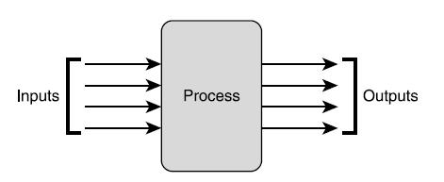
Steps in Building a Program
Analyze the Problem

Slide 16
Example
Write a JAVA program that will calculate the perimeter of a rectangle based on the length and width given by user. The program will display the calculated perimeter. The perimeter is calculated by using this formula:
Perimeter = 2 x (length + width)
Input? → length, width
Process? → Perimeter = 2 x (length + width)
Output? → Perimeter

Slide 17
Steps in Building a Program
Develop an Algorithm
Write the algorithm in pseudocode or flowchart.
Need to identify the basic steps clearly in the correct order from what you found in the analysis step.
Typically, the steps follows similar pattern:
input, process and output.

Slide 18
Algorithm
An algorithm is a clear step–by-step sequence of instructions to solve a problem
Analogy: recipe (refer next slide).
In computing, an algorithm is a procedure (a finite set of a well-defined instructions) for accomplishing some task which, given an initial state, will terminate in a defined end-state.

Slide 19
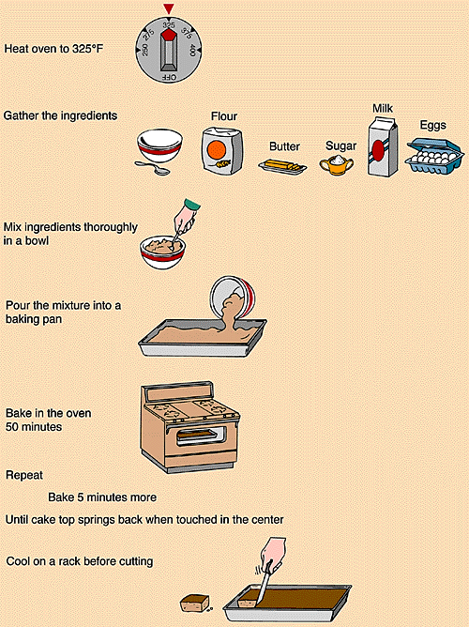
Algorithm
Baking a Cake

Slide 20
Algorithm
2 ways to represent algorithm:
a) Pseudo code
using English-like statements to list the steps to be taken in the solution.
b) Flowchart
using diagrams that employ symbols to describe the workflow of steps involved in the solution.

Slide 21
Pseudocode
Pseudocode statements usually perform input, output, and processing.
The input statements are to get data needed to perform computation e.g.:
READ studentName, studentMark
GET length, width, height of a box
OBTAIN loan_amount, interest_rate, loan_duration
The output statements are to display information for the user e.g.:
DISPLAY finalGrade
PRINT "The volume of the box is " +theVolume
PRINT "The loan monthly payment " +monthlyPayment

Slide 22
Pseudocode
The processing statements are to perform computation e.g.:
CALCULATE priceAverage AS (price1 +price2 + price3) / 3
COMPUTE volume AS length x width x height
DETERMINE BMI AS weight / (height x height)

Slide 23
Pseudocode to calculate the perimeter of a rectangle
Start
READ length, width
CALCULATE perimeter AS 2 x (length + width)
Display perimeter
End

Slide 24
Flowchart
A graphical way of depicting a problem in terms of its inputs, outputs, and processes.
The basic elements are as follows:
Rounded Rectangle (start/end of a program)
Parallelogram (program input and output)
Rectangle (processing)
Diamond (decision)
Arrow (execution flow)

Slide 25

Flowchart to calculate the perimeter of a rectangle
Start
READ length, width
Perimeter = 2 x (length + width)
DISPLAY perimeter
End

Slide 26
Steps in Building a Program
Test an Algorithm:
Pretend that you are the computer and follow the steps of your algorithm explicitly while keeping track of how the variables are changing.
Hand trace the values of the variables in every steps of your algorithm to verify its correctness.

Slide 27
TEST ALGORITHM to calculate the perimeter of a rectangle
Start
READ length, width → (20,10)
CALCULATE perimeter = 2 x (length + width) → 2 x (20+10)
DISPLAY perimeter → 60
End

Slide 28
Steps in Building a Program
Code the program:
Develop the program by coding the algorithm in a programming language, such as Java.
Need to have knowledge in the programming language in terms of the language syntax.
Can use IDEs such as Eclipse, NetBeans, JGRASP, etc to facilitate the coding tasks.

Slide 29
Hello World PSEUDOCODE & JAVA CODE
Start
PRINT “Hello World!”
End
Start
public class Hello
{
public static void main(String[] args)
{
// display a greeting in the console window
System.out.println("Hello World!");
}
}
PRINT “Hello World”
End

Slide 30
ALGORITHM & JAVA CODE to calculate the perimeter of a rectangle
Start
READ length, width
CALCULATE perimeter = 2 x (length + width)
DISPLAY perimeter
End
Start
Input length, width
public class CalculatePerimeter
{
public static void main(String[] args)
{
Scanner scan = new Scanner (System.in);
System.out.println("Insert the length");
int length = scan.nextInt();
System.out.println("Insert the width");
int width = scan.nextInt();
int perimeter = 2 * (length + width);
System.out.println("The perimeter of rectangle is"+perimeter);
}
}
Perimeter = 2 x (length + width)
Output perimeter
End

Slide 31
Steps in Building a Program
Test/Debug Program:
Test to verify that the program meets the requirements by creating test cases. (Compare the hand-traced value with the output from the code)
Test can avoid bugs such as logic errors.
Program also need to be maintained by modifying it if the problem domain or requirements changes or problem arises.

Slide 32

TODAY’S TAKE AWAY
Two types of problems nature
Types of solution for a problem
Steps in building a program

Slide 33

EXERCISE 1
Write pseudo code and draw a flowchart for a program which calculates the carry marks for a subject.
The formula used to calculate the carry marks is:
carryMarks = midSem + assignment + quiz

Slide 34
EXERCISE 2
Write pseudo code and draw a flowchart for a program that:
reads the length, width and height of a box, calculate and display its volume. The volume is calculated by multiplying the length, width and height .

Slide 35
EXERCISE 3
Write pseudo code and draw a flowchart for a program that:
calculates and displays a circle area based on its radius. The formula to calculate area is πr²
where r = radius and π = 3.142.

Slide 36
EXERCISE 4
Write pseudo code and draw a flowchart for a program that:
asks the user to input an amount in US Dollar (USD), read it and then covert to Malaysian Ringgit (RM). Assume that USD1 is equivalent to RM4.20. Display RM value calculated by your program.

Slide 37
EXERCISE 5
Write pseudo code and draw a flowchart for a program that:
reads three test scores for a student. Find the average score achieved for that student.

Slide 38
EXERCISE 6
Write pseudo code and draw a flowchart for a program that:
calculates the total price needs to be paid by visitors Legolands Theme Park. Assume that the ticket price is RM50 per person (adult and children).

Slide 39
EXERCISE 7
Write pseudo code and draw a flowchart for a program that:
calculates the payment for parking a car in a car park based on hours parked. Each hour is charged RM1.50. The program should calculate and display the total payment that needs to be paid when a user parks the car.

Slide 40
EXERCISE 8
Write pseudo code and draw a flowchart for a program that:
calculates total payment for grocery bought by customers. It reads the name of item, its price and quantity. Then the item name and total price for the item are displayed.

Slide 41
EXERCISE 9
You would like to develop a simple ATM Machine for withdrawing money. The user of this ATM Machine should provide the total balance in the account before withdrawal and the total withdrawal amount. At then end, the ATM machine will display the total account before withdrawal, withdrawal amount and balance after withdrawal.
Write pseudo code and draw a flowchart

Slide 42
EXERCISE 10
Write pseudo code and draw a flowchart for a program that:
reads the actual price of a Bonia handbag and its discount percentage. It calculates and print the price of handbag that needs to be paid.

Slide 43
Additional exercises

Slide 44
EXERCISE 1
Write pseudo code and draw a flowchart for a program that:
computes the sum of two numbers. If the sum is below or equal to twenty, two numbers will be entered again. If the sum is above 20, it will display the sum..

Slide 45
EXERCISE 2
Create an algorithm (pseudo and a flowchart) that converts a numeric grade to a pass/no pass grade.

Slide 46
EXERCISE 3
Create an algorithm (pseudo and a flowchart) that will output the largest number among three numbers entered by the user.

Slide 47
EXERCISE 4
Create an algorithm (pseudo and a flowchart) that compute the GRADE which is the average of 4 different Marks, then displays “FAIL” if the GRADE is less than 50. Otherwise, “PASS” is printed.

